Slide 1
Identifying Fermi LAT sources with X-ray and multiwavelength data.

Slide 2
Introduction
Growing number of Fermi LAT sources, improving coverage of Galactic plane with Chandra (CXO) and XMM-Newton X-ray observatories , and deeper high-resolution optical, NIR, and radio surveys enable multiwavelength classification of unidentified LAT sources. These are typically very labor-intensive because of the large number of sources and large number of multiwavelength parameters (features) characterizing them. Therefore, Machine-Learning (ML) methods can be of a great help.

Slide 3
Sample definition
We have been analyzing unidentified 3FGL source located within <10 degrees from the Galactic plane. However, since with the recent release of 4FGL positions and significance of Galactic 3FGL source have changed substantially (see below). Therefore, we focus here only on those LAT sources whose 3FGL and 4FLG positions fall within 8’ (for ACIS-I) and 4’ (for ACIS-S) from the CXO pointing (which in many cases was not even intended to study the LAT source).
4FGL catalog has several “kinds” of “unidentified” sources. Some sources are “associated” with known sources but the associations are uncertain. Below we only consider sources that are listed as in 4FGL catalog without any class or with class “unknown”. Note that some of these sources turn out to have credible associations that are not listed in the released 4FGL catalog (see an example below).

Slide 4
3FGL vs. 4FGL
Galactic Fermi LAT sources have a known tendency to disappear or move around in new releases.
Within |b|<10 deg, only about 50% of unidentified 3FGL sources overlaps (within the 95% confidence positional uncertainties) with the 4FGL sources.

Slide 5
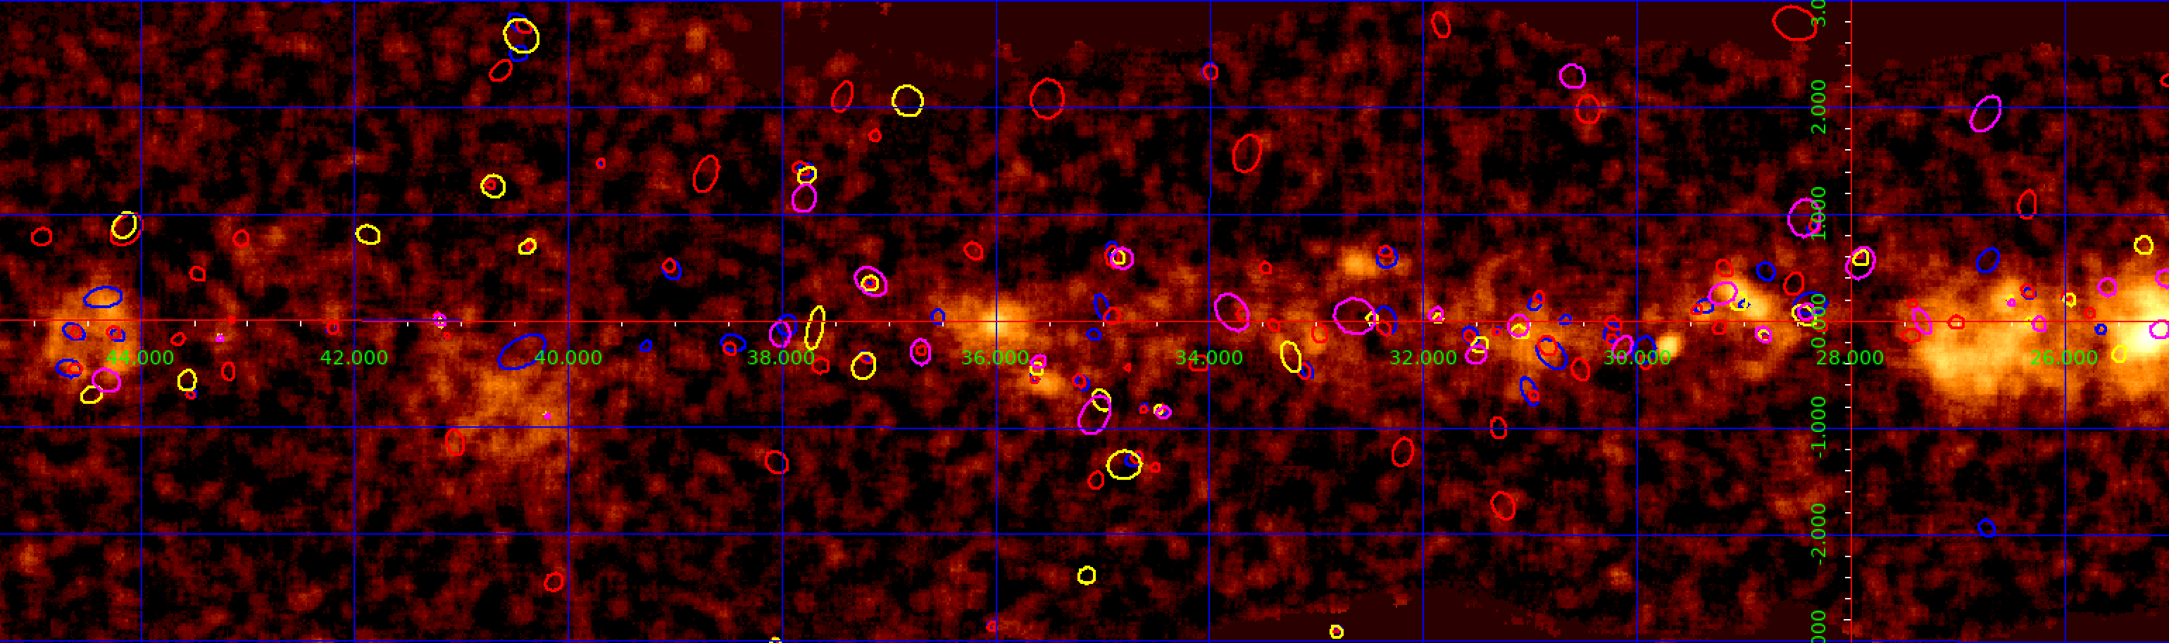
Fig 1. A region of Galactic plane (the background image if from the H.E.S.S. Galactic Plane survey) with 2FGL (magenta), 3FGL (yellow), 8-yr prelim (red), 4FGL (blue) 95% confidence ellipses shown.

Slide 6
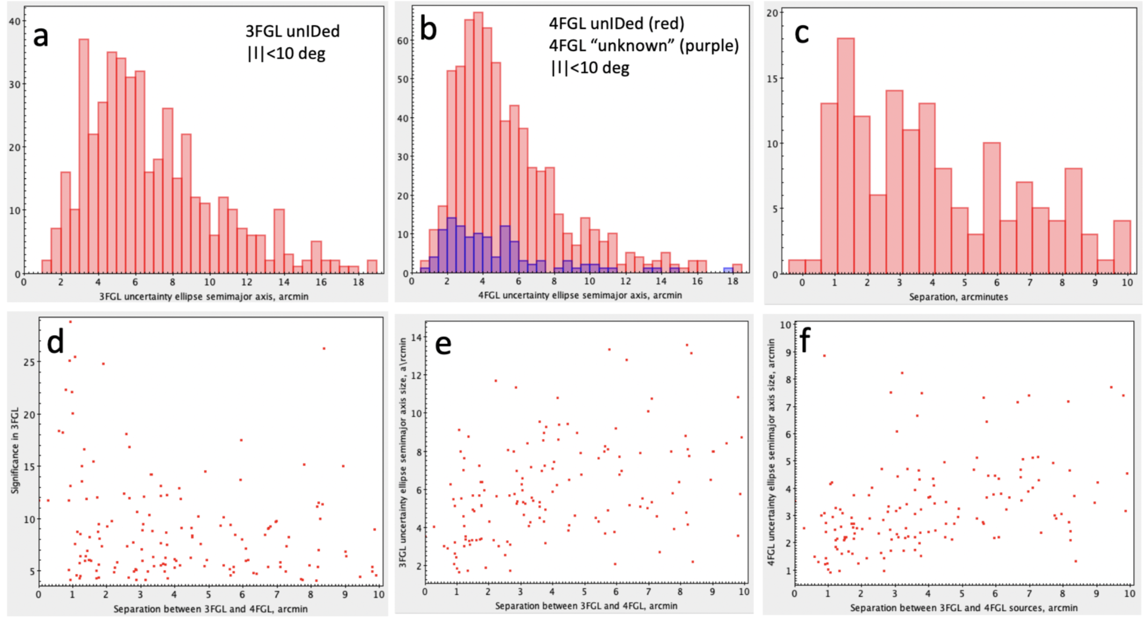
The 3 upper panels show the histograms for unIDed Galactic (|b|<10 deg). Panels a and b show the histograms of semimajor uncertainty ellipse for 3FGL and 4FGL sources. Panel c shows the distribution of offsets between the unIDed 3FGL and 4FGL sources whose positions are <10' from each other. The three bottom panels show the significance of the 3FGL LAT source (having a match in 4FGL within r<10'; panel d) and the size of the uncertainty ellipse (in 3FGL and 4FLG, panels e and f) as a function of separation between the 3FGL source and its best match in 4FGL. One can see that the offset between the 3FGL and 4FGL source does not depend noticeably on the 3FGL source significance and that the correlation between the source uncertainty ellipse size and the separation improves if the 4FGL positional uncertainty is used (i.e. localized 4FGL sources tend to be closer to their 3FGL predecessors).

Slide 7
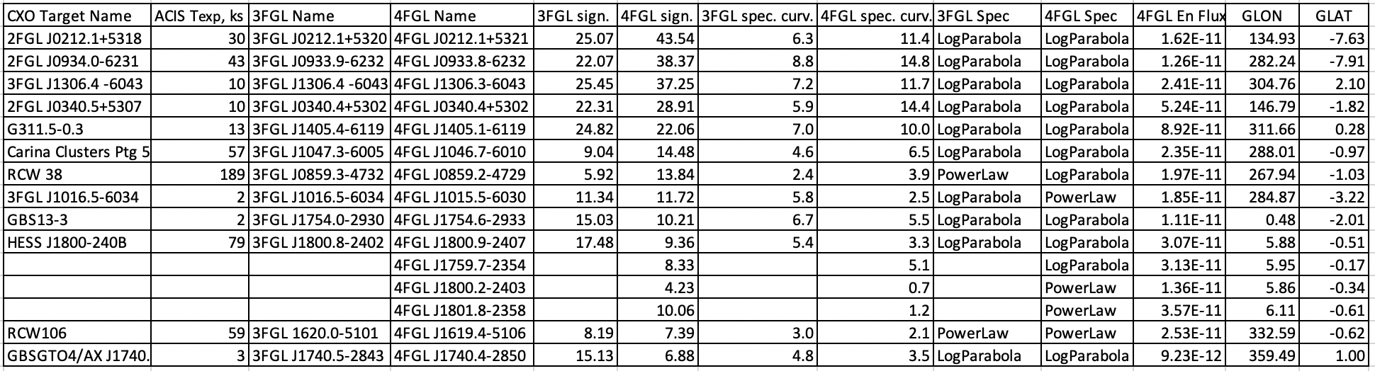
Investigated objects

Slide 8
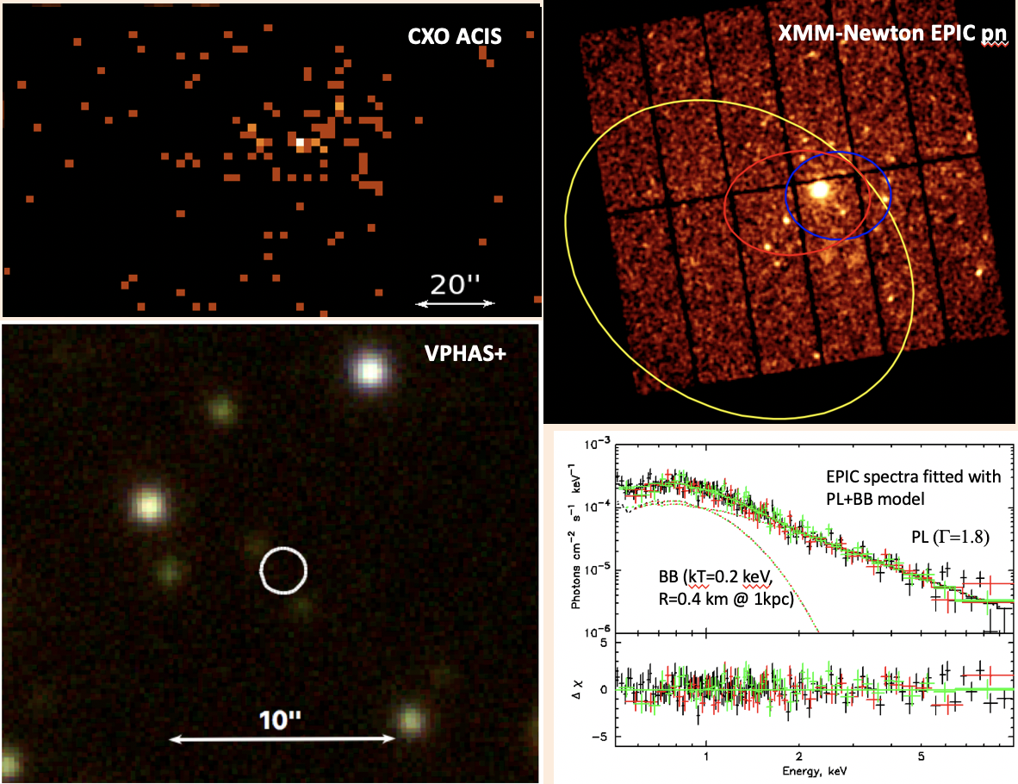
4FGL J1015.5-6030
A 2-ks CXO AXIS exposure resolves the bright source into an extended nebula with a hard spectrum and a point source. The point source has neither NIR nor radio counterpart. The XMM-Newton EPIC spectrum of the bright source (including compact nebula seen in the CXO image) fits well an absorbed blackbody+power-law (BB+PL) model. Likely classification is a young pulsar with a pulsar wind nebula. No pulsations are seen in EPIC pn but the pn time resolution was limited to 72 ms. Further observations are proposed this year.

Slide 9
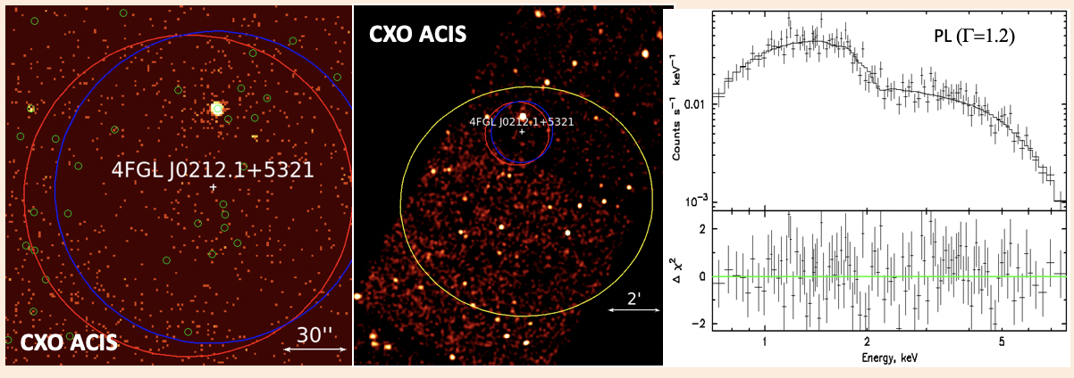
4FGL J0212.1+5321 (not really unIDed !)
This source is listed as unknown in 4FGL so it got selected for the analysis. However, we quickly realized that it a know source – a redback candidate (no pulsations reported yet) based on optical identification of 21-hr binary with low-mass companion (Linares et al. 2016). CXO position allowed for identification.

Slide 10
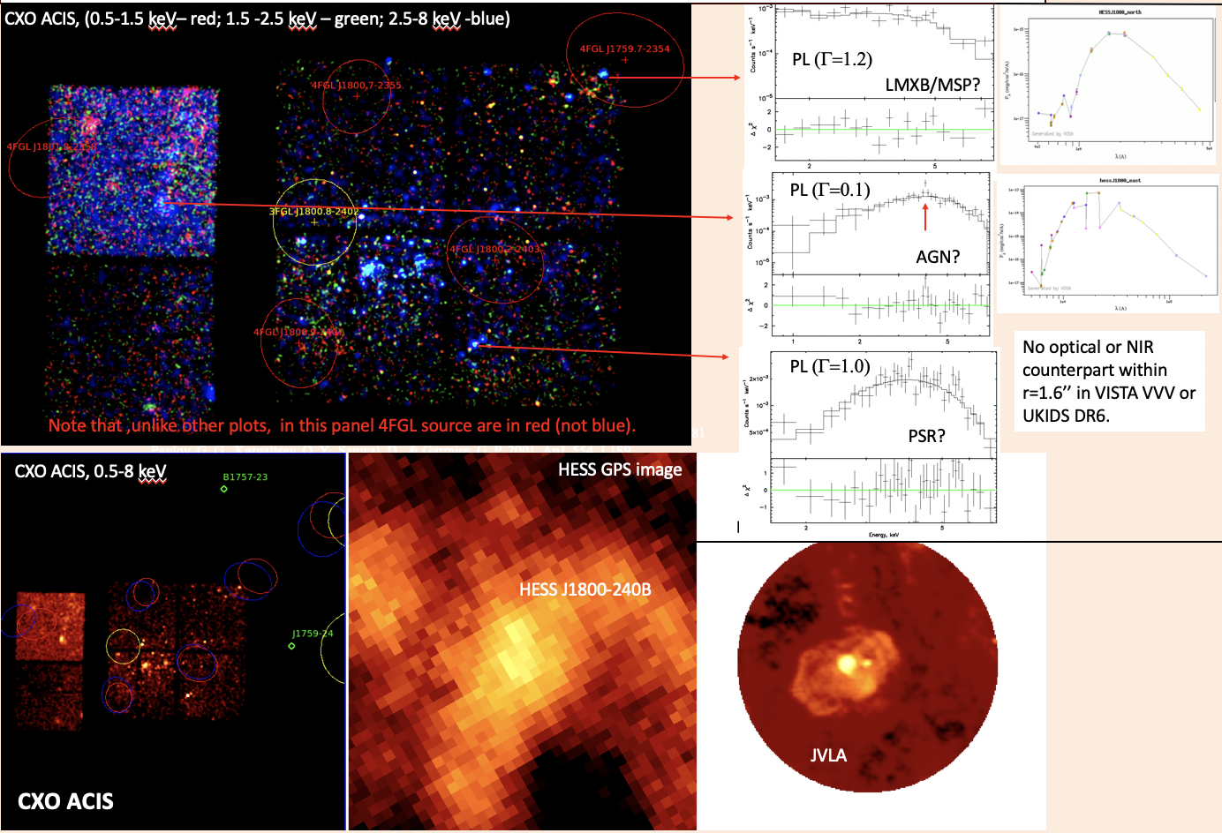
3FGL J1800.8-2402
This is difficult but not uncommon case when a single 3FG source (3FGL J1800.8-2402) morphed into several (in this case 4) 4FGL sources. The position of 3FGL source was close to two HI regions but 4FLG source are far. Can we trust those sources? We extracted the spectra of 3 brightest hard X-ray sources and looked for their counterparts in optical, NIR, and radio.

Slide 11
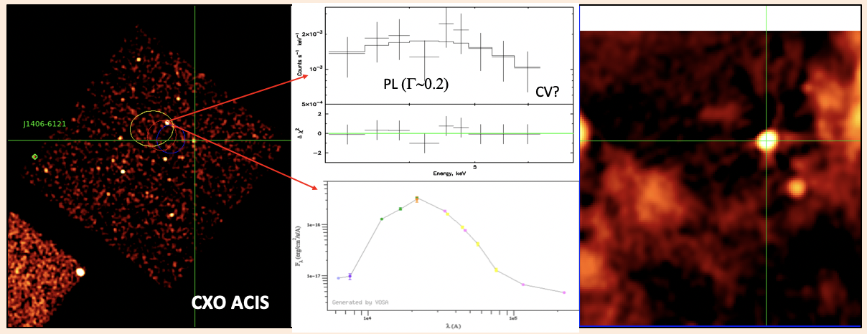
4FGL J1405.1-6119
Although the CXO target was declared as SNR G311.5-0.3, the R=1.5’ SNR is 36’ south of the CXO pointing. However the pointing covers the Fermi LAT source which has nothing to do with SNR. There is only one faint X-ray source within the 4FGL ellipse with very hard spectrum and stellar type optical counterpart. It could be either quiescent LMXB or CV but then the association with GeV source is doubtful. If the actual position of the GeV source is a bit more to the west, then there is a bright radio counterpart that has X-ray counterpart (likely an AGN).

Slide 12
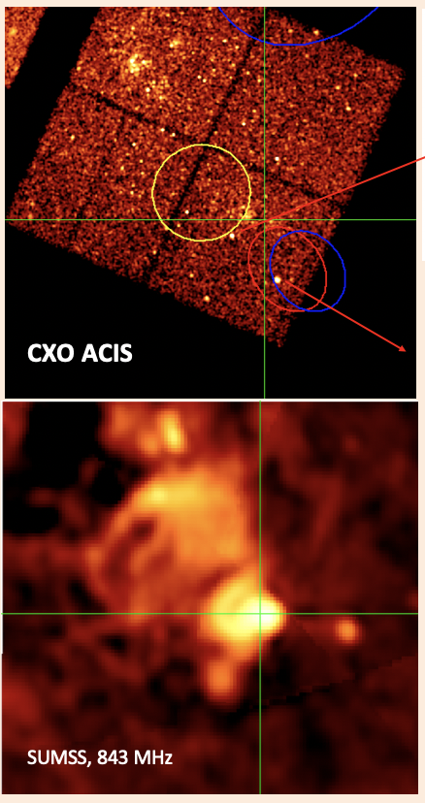
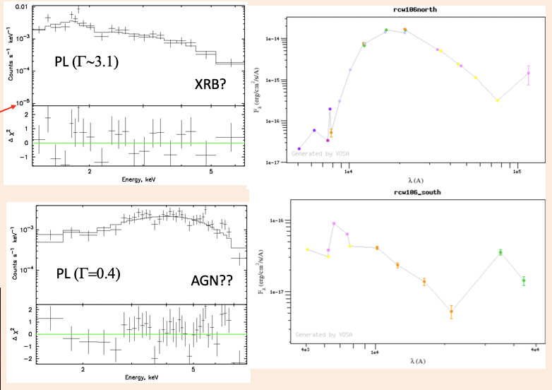
4FGL J1619.4-5106
This source is in the field of star-forming region RCW 106 but the new 4FGL position is shifted south-west from RCW 106. The bright radio source is outside the 95% uncertainty ellipse of the 4FGL source . The bright X-ray source shows evidence of redshifted Fe line in the X-ray spectrum and IR excess in the optical-NIR-IR spectrum. If the spectrum is stellar the temperature could be high or it is nonthermal spectrum with an absorption or inaccurate photometry. We continue looking into this.

Slide 13
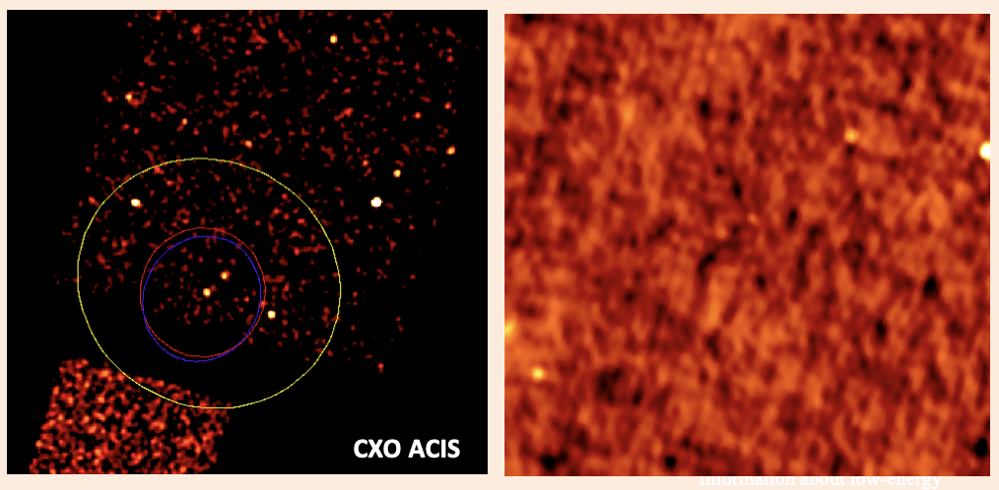
4FGL J0340.4+5302
There are two relatively faint X-ray sources within the 4FGL positional uncertainty ellipse which is within the 3FGL ellipse and is significantly smaller. This gives more confidence to 4FGL source and its position. Saz Parkinson et al. (2016) classify (using ML) the 3FGL source as a young pulsar based on the 3FG properties alone.

Slide 14
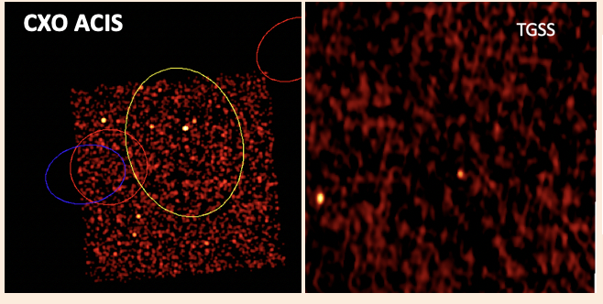
4FGL J1754.6-2933
The CXO observation is from the Galactic Bulge survey (GBS13-3). While the 3FGL source had a relatively bright X-ray source inside its 95% uncertainty ellipse, the 4FGL ellipse may be empty (no X-ray source). How much should we trust 4FGL? Investigation is ongoing…

Slide 15
Summary and Conclusions
We have found a promising young pulsar candidate with a luminous PWN (3FGL J1016.5-6034). A short CXO imaging observation played a crucial role in the identification of this source. We also found two more pulsar candidates one of which may be in a low mass binary. In addition, we found some CV and AGN candidates but CVs (except when in nova outburst) are not known to be GeV sources.
Acknowledgements
We acknowledge the support for this work from NASA award 80NSSC17K0760 and Chandra award AR3-14017X.

